Slide 1
General Meeting #9
MOVING IN PREPROCESSING STAGE
October 24th, 2021

Slide 2
Sampling
PRECURSOR TO HYPOTHESIS TESTING

Slide 3
Key Takeaways of Last Lecture
A LOT OF CONTENT SAME GENERAL THEME
Last meeting there was a lot of content thrown at you so wanted to go through some key takeaways before continuing
Modeling is a method of trying to show a relationship within data
We do this through training the model so that it can be generalized to a population
There were also several requirements that our data had to meet before it could be put into a model:
A linear relationship
Multivariate normality
Little-to-no multicollinearity
No autocorrelation
Homoscedasticity
Today we are going to go over some information about sampling as well as preprocessing

Slide 4
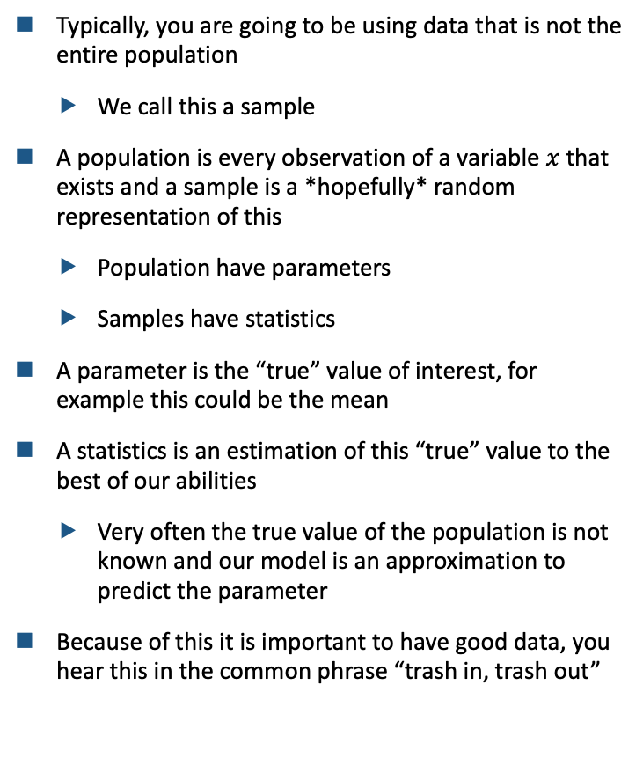
Parameters vs. Statistics
WHAT THE DATA WE HAVE MEANS
Typically, you are going to be using data that is not the entire population
We call this a sample
A population is every observation of a variable $x$ that exists and a sample is a *hopefully* random representation of this
Population have parameters
Samples have statistics
A parameter is the “true” value of interest, for example this could be the mean
A statistics is an estimation of this “true” value to the best of our abilities
Very often the true value of the population is not known and our model is an approximation to predict the parameter
Because of this it is important to have good data, you hear this in the common phrase “trash in, trash out”

Slide 5
Sampling Methods
TYPICALLY A SIMPLE RANDOM SAMPLE IS PREFERRED
Because we want our estimation of the population to be unbiased we need an unbiased sample
This is the “easiest” method of sample, but there are a few cases to avoid:
Convenience: make sure that the sample is not created because it is easy
Non-Random: this seems obvious but the data collected needs to be from a sampling frame that is representative of the population
The term “sampling frame” refers to the area that you are sampling from
Your predictions and modeling can extrapolate to your sampling frame
Thus, if your sampling frame is not representative of a large population your model has limited scope
Prefer SRS because it allows for us to control for confounders (get into that later), but this probably the most important thing in this deck

Slide 6
Important Qualities of a Sample
SOME KEYS TAKEAWAYS ON PITFALLS OF SAMPLING
In sampling we know that there is going to be variability
Sampling variability: the difference between statistics (which estimate the parameter) from sample-to-sample
We would expect there to be difference between samples because they are an attempt to represent a population
If we observe a relationship in our sample which we believe is meaningful, how do we know that it is not due to random chance?
Specifically, currently we do not know a method verifying whether or not our sample’s model is simply a representation of random chance or not
So…

Slide 7
Brief Aside on Hypothesis Testing
VERY IMPORTANT TO UNDERSTAND (EXTREMELY)

Slide 8
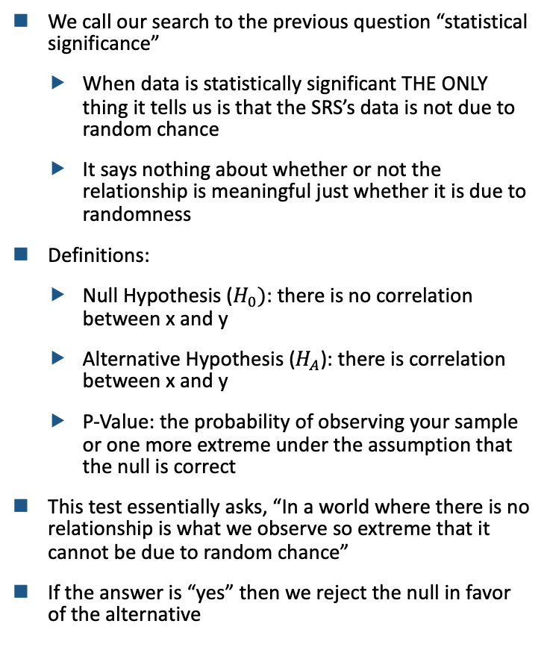
Definitions
SOME QUICK DEFINTIONS
We call our search to the previous question “statistical significance”
When data is statistically significant THE ONLY thing it tells us is that the SRS’s data is not due to random chance
It says nothing about whether or not the relationship is meaningful just whether it is due to randomness
Definitions:
Null Hypothesis ($H_{0})$: there is no correlation between x and y
Alternative Hypothesis ($H_{A}$): there is correlation between x and y
P-Value: the probability of observing your sample or one more extreme under the assumption that the null is correct
This test essentially asks, “In a world where there is no relationship is what we observe so extreme that it cannot be due to random chance”
If the answer is “yes” then we reject the null in favor of the alternative

Slide 9
Finding a P-Value
WEIRD BUT IMPORTANT PART OF STATISTICS
As a general note, we are using ”correlation” right now but any number of factors could be used
A more general form would be, “Given no [relationship you are testing] is the [relationship] so extreme that it is not due to random chance”
Lets continue using correlation for simplicity, but no that it can be generalized (and will be shortly)
Typically, a cut off of 0.05 is used as the p-value meaning that we want a low probability
Because our p-value ASSUMES the null hypothesis is correct we want it be low because if the probability of get our sample again is low it means that it is more probably it is not due to randomness
Luckily, pretty much any model that you run is going to report a p-value along side the results and they are also used in many statistical chance, summary:
Low p-value = good
High p-value = not necessarily a good sample

Slide 10
Testing Assumptions for Linear Models
NOW GOING OVER HOW TO TEST THE ASSUMPTIONS OF LINEAR MODELS

Slide 11
Sampling is Complete… What Next?
WE NEED TO CHECK MODEL ASSUMPTIONS: LINEARITY
The linear assumption seems easy to meet but sometime it can be a tough question as to whether data is linear
For example, would we call data that follows a straight line and then at the last second curve up “linear”?
To what degree of variability in the scatter of data do we accept before the relationship is non-linear
There are three methods you can use to check linear (probably best to use all three):
Graphing: simply graph your independent and dependent variables on a scatter graph to see if there is a linear relationship
Linear-Rainbow: explained later
Correlation: use Pearson Correlation Coefficient to find the relationship between the variables

Slide 12
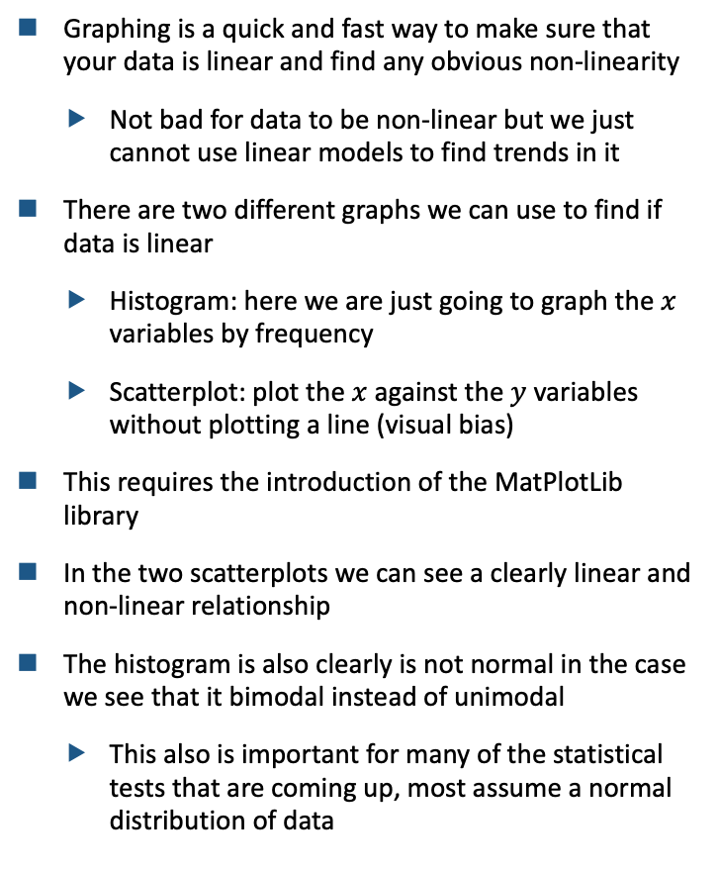
Linearity Assumption: Graphing
EASY TO CHECK METHOD ON LINEARITY ASSUMPTION
Graphing is a quick and fast way to make sure that your data is linear and find any obvious non-linearity
Not bad for data to be non-linear but we just cannot use linear models to find trends in it
There are two different graphs we can use to find if data is linear
Histogram: here we are just going to graph the $x$ variables by frequency
Scatterplot: plot the $x$ against the $y$ variables without plotting a line (visual bias)
This requires the introduction of the MatPlotLib library
In the two scatterplots we can see a clearly linear and non-linear relationship
The histogram is also clearly is not normal in the case we see that it bimodal instead of unimodal
This also is important for many of the statistical tests that are coming up, most assume a normal distribution of data

Slide 13
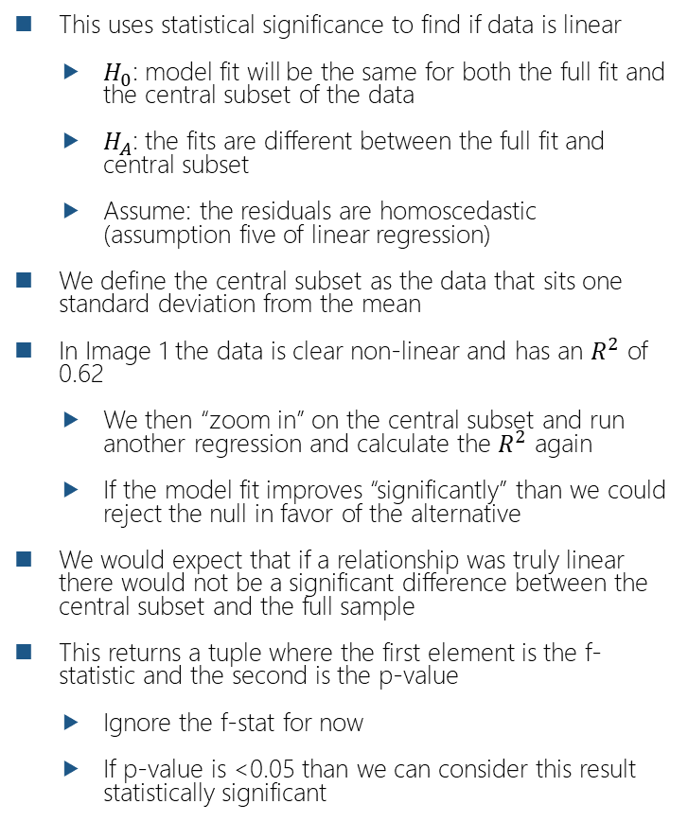
Linearity Assumption: Linear Rainbow
SIMPLE STATISTICAL TEST USED TO FIND IF THE CENTAL DATA IS LINEAR IN NATURE
This uses statistical significance to find if data is linear
$H_{0}$: model fit will be the same for both the full fit and the central subset of the data
$H_{A}$: the fits are different between the full fit and central subset
Assume: the residuals are homoscedastic (assumption five of linear regression)
We define the central subset as the data that sits one standard deviation from the mean
In Image 1 the data is clear non-linear and has an $R^{2}$ of 0.62
We then “zoom in” on the central subset and run another regression and calculate the $R^{2}$ again
If the model fit improves “significantly” than we could reject the null in favor of the alternative
We would expect that if a relationship was truly linear there would not be a significant difference between the central subset and the full sample
This returns a tuple where the first element is the f-statistic and the second is the p-value
Ignore the f-stat for now
If p-value is <0.05 than we can consider this result statistically significant
f-statistic
p-value
In the statsmodels we have to add a constant manually which is automatically done in scikit

Slide 14
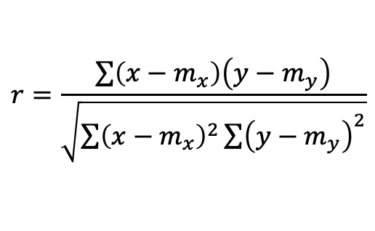
Linearity Assumption: Correlation
ANOTHER STATISTICAL TEST FOR LINEARITY
The LR test examined the sample data that we provided with the central subset
Now we will use Pearson Correlation to see if there is a linear relationship within the data
We assume (hopefully verify) that the data is normally distributed
Though this assumption is only relevant for the p-value calculation
Returns a value between -1 and +1 with 0 being no correlation
The closer that the absolute value of the correlation coefficient is to 1 the stronger the linear relationship
There are alternatives to Pearson which will learn but this is the most basic
Pearson data is also assumed to be continuous but we will learn more about this later
correlation
p-value
$$r=\frac{\sum{\left(x−m_{x}\right)\left(y−m_{y}\right)}}{\sqrt{\sum{{\left(x−m_{x}\right)}^{2}\sum{{\left(y−m_{y}\right)}^{2}}}}}$$

Slide 15
Multivariate Normality
ASSUMPTION THAT THE RESIDUALS ARE NORMALLY DISTRIBUTED
Multivariate normality means that the residuals of a model are normally distributed
This test is run once you have a model because you need residuals
Multivariate normality derives from the variables themselves being normally distributed
If you take a linear combination of variables (non-dichotomous) we expect the new distribution to be normal as well
We can say for the residuals of the model that they should be normally distributed (non-dichotomous)
Ways to test:
Scatterplot: simply graph points together to see if there is any collinearity
VIF: statistical test used

Slide 16
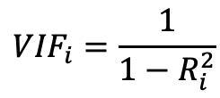
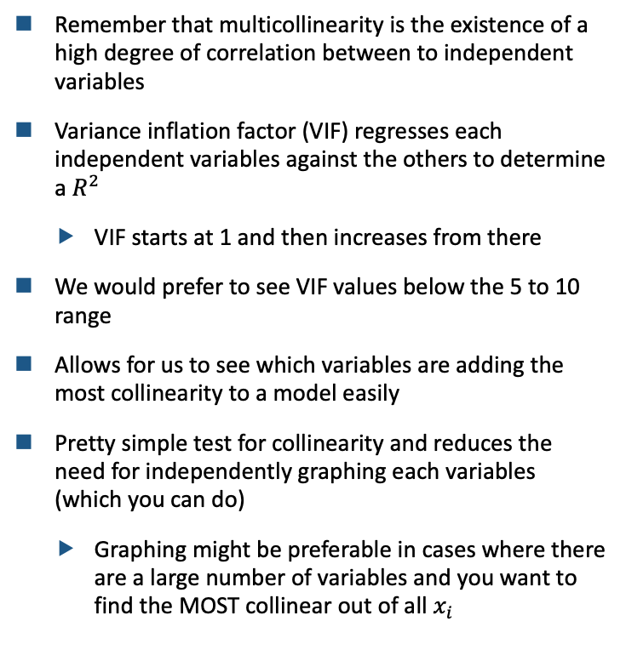
Multicollinearity
EASY TO CHECK USING VIF
Remember that multicollinearity is the existence of a high degree of correlation between to independent variables
Variance inflation factor (VIF) regresses each independent variables against the others to determine a $R^{2}$
VIF starts at 1 and then increases from there
We would prefer to see VIF values below the 5 to 10 range
Allows for us to see which variables are adding the most collinearity to a model easily
Pretty simple test for collinearity and reduces the need for independently graphing each variables (which you can do)
Graphing might be preferable in cases where there are a large number of variables and you want to find the MOST collinear out of all $x_{i}$
$${VIF}_{i}=\frac{1}{1−R_{i}^{2}}$$

Slide 17
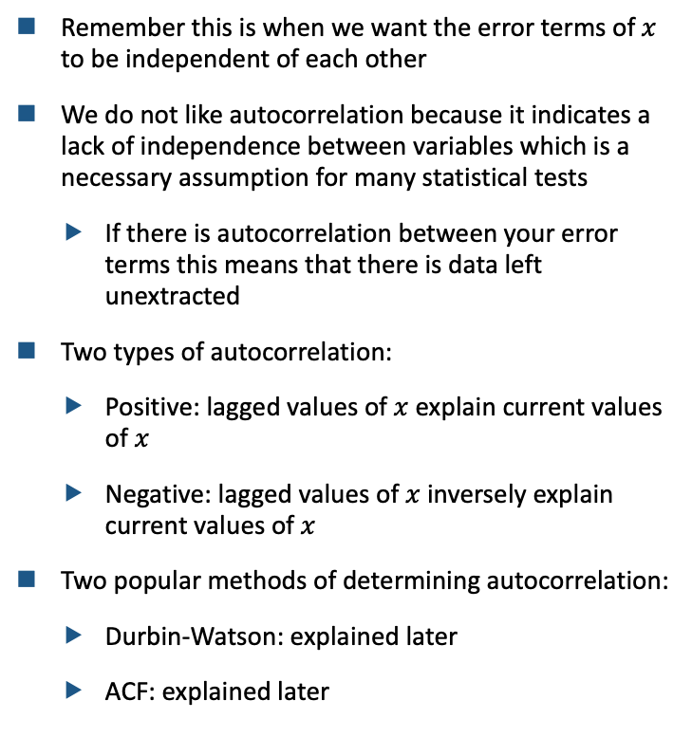
Autocorrelation of Errors
AUTOCORRELATION IS THE LAGGED TIME RELATIONSHIP
Remember this is when we want the error terms of $x$ to be independent of each other
We do not like autocorrelation because it indicates a lack of independence between variables which is a necessary assumption for many statistical tests
If there is autocorrelation between your error terms this means that there is data left unextracted
Two types of autocorrelation:
Positive: lagged values of $x$ explain current values of $x$
Negative: lagged values of $x$ inversely explain current values of $x$
Two popular methods of determining autocorrelation:
Durbin-Watson: explained later
ACF: explained later

Slide 18
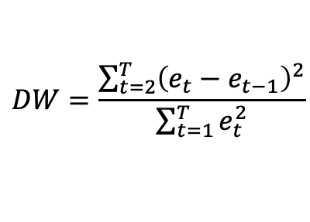
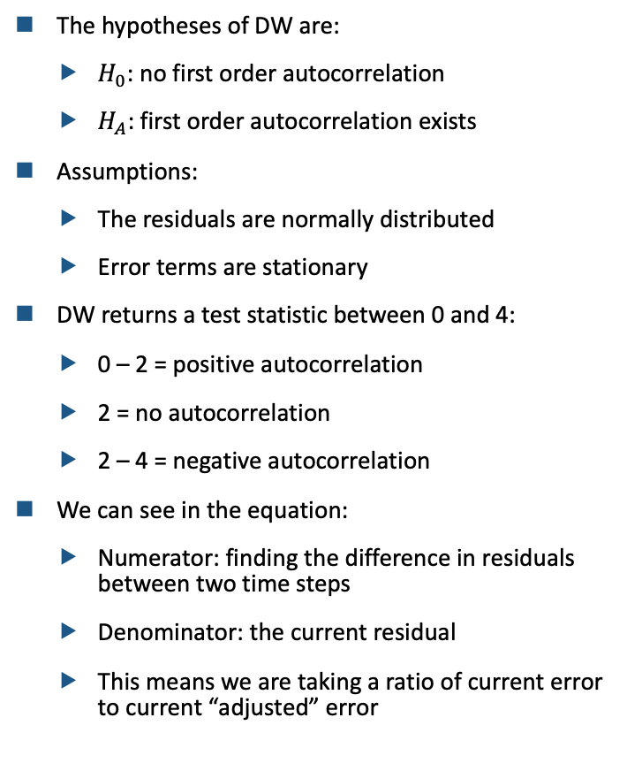
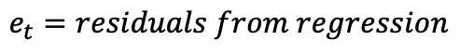
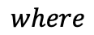
Autocorrelation: Durbin-Watson
STATISTICAL TEST THAT TESTS FOR AUTOCORRELATION
The hypotheses of DW are:
$H_{0}$: no first order autocorrelation
$H_{A}$: first order autocorrelation exists
Assumptions:
The residuals are normally distributed
Error terms are stationary
DW returns a test statistic between 0 and 4:
0 – 2 = positive autocorrelation
2 = no autocorrelation
2 – 4 = negative autocorrelation
We can see in the equation:
Numerator: finding the difference in residuals between two time steps
Denominator: the current residual
This means we are taking a ratio of current error to current “adjusted” error
$$DW=\frac{\sum_{t=2}^{T}{{\left(e_{t}−e_{t−1}\right)}^{2}}}{\sum_{t=1}^{T}{e_{t}^{2}}}$$
$$where$$
$$e_{t}=residuals from regression$$

Slide 19
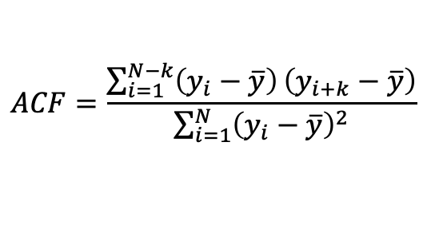
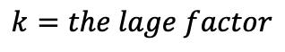
Autocorrelation: ACF
SIMPLE IF YOU UNDERSTAND DURBIN-WATSON
A very similar function to DW
We give the lag amount to the function through the variable k
Assumes that time series elements are equidistant from each other
Instead of a single statistics it returns a level of autocorrelation (0– 1) for each step in time lagged
$$ACF=\frac{\sum_{i=1}^{N−k}{\left(y_{i}−\overline{y}\right)}\left(y_{i+k}−\overline{y}\right)}{\sum_{i=1}^{N}{{\left(y_{i}−\overline{y}\right)}^{2}}}$$
$$where$$
$$k=the lage factor$$

Slide 20
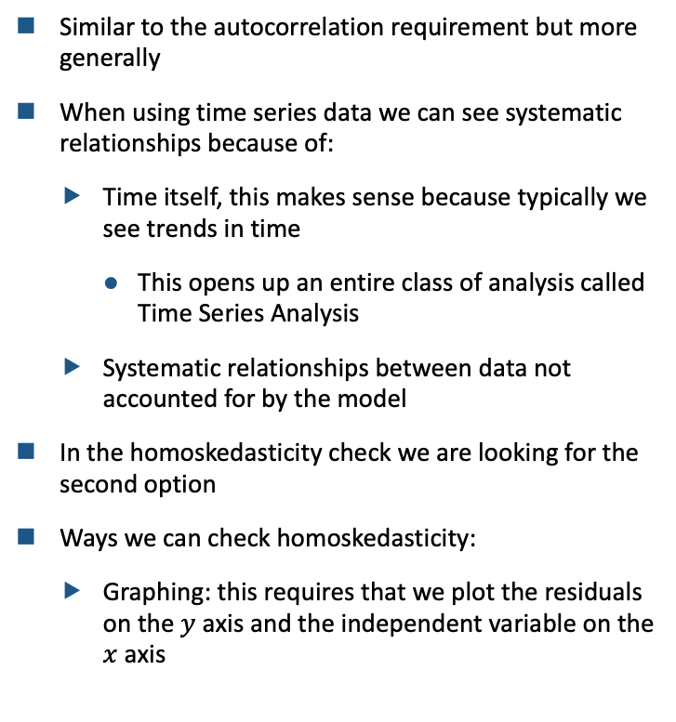
Homoskedasticity
CHECKING TO ENSURE NO SYSTEMATIC RELATIONSHIP EXISTS IN RESIDUALS
Similar to the autocorrelation requirement but more generally
When using time series data we can see systematic relationships because of:
Time itself, this makes sense because typically we see trends in time
This opens up an entire class of analysis called Time Series Analysis
Systematic relationships between data not accounted for by the model
In the homoskedasticity check we are looking for the second option
Ways we can check homoskedasticity:
Graphing: this requires that we plot the residuals on the $y$ axis and the independent variable on the $x$ axis

Slide 21
Corrections of the Violations of Linear Model Assumptions
CALLED THE PREPROCESSING STAGE

Slide 22
Intuition
WHY DO WE NEED TO MAKE THESE ADJUSTMENTS
As you might have noticed in the previous section a large number of statistical tests require a normal distribution of the independent variable
We can see samples where the data looks Gaussian but it fails normality tests, this requires adjustment
In cases where there is very little or even no appearance of a Gaussian distribution we can increase the sample size
There are three ways that we can create non-Gaussian data:
Normalization: converting every variable to be between 0 and 1
Standardization: converting the data so that it has a mean of 0 and standard deviation of 1
Transformation: performing a function each point of the data
Before we go any further I think it would be good to do a content review and just questions in general

